Slide 1
SPREAD SMILES
Giving is not just about make a donation, it’s about making a difference.
Team members:
Sushmitha C G
Sowmya H L
Uravakonda Kamal Mayukha

Slide 2
Agenda
We all have been affected by the current COVID-19 pandemic. However, the impact of the pandemic and its consequences are felt differently depending on our status as individuals and as members of society.
The primary reason behind choosing this project is to help those people in need of food and medicines in these difficult times.
This website reduces the efforts to provide or get help personally in offline mode and help those people who are in need of essentials like food and medicines.

Slide 3
Introduction
This project aims to donate excess food and unused medicines.
It provides an online platform in the form of a website to connect the help providers and help seekers.
It connects the people who have excess food and who are in need of food. Then the unused medicine can be donated to NGO for further utilization by a needy person.
The system will provide the serving activity in quick and easy manner via volunteers.

Slide 4
Existing System
These days, there are many COVID patients who are in need of food but on the other hand, a lot of food is being wasted in restaurants and households. Also, a lot of medicines is going unused in many households.
Although there are similar websites to donate excess food, most of them don’t allow individuals to donate small amount of food.
Thus, our system provides solution to this problem by encouraging small donations and help the needy.

Slide 5
Proposed System
This project basically aims to donate excess food and the medicines which are unused.
This application connects the people who have excess food and who are in need of food. Then the unused medicine can be donated to NGO for further utilization by a needy person.
It overcomes the rejection of small contribution of food and medicines, we collect all amounts of food from any individual.
It also contains delivery facility by the available volunteers, in the cases where donor and recipient are not able to contact each other.

Slide 6
Proposed System
In user interface, there will be 3 roles:
Donor: one who has food/medicines can post it in our website by providing essential details.
Recipient: the individuals/organizations who are in need of food can see the posts posted by donors and apply for any one of them.
Volunteer: When neither the donor nor the recipient can contact each other, volunteers can take up this work by registering themselves. They are also responsible for collecting medicines and each week those unused medicines will be given to NGO registered prior.

Slide 7
Technologies Used
Front End: HTML, CSS, JavaScript, Bootstrap
Backend: NodeJS, Express JS, MongoDB database
IDE: Visual Studio Code

Slide 8
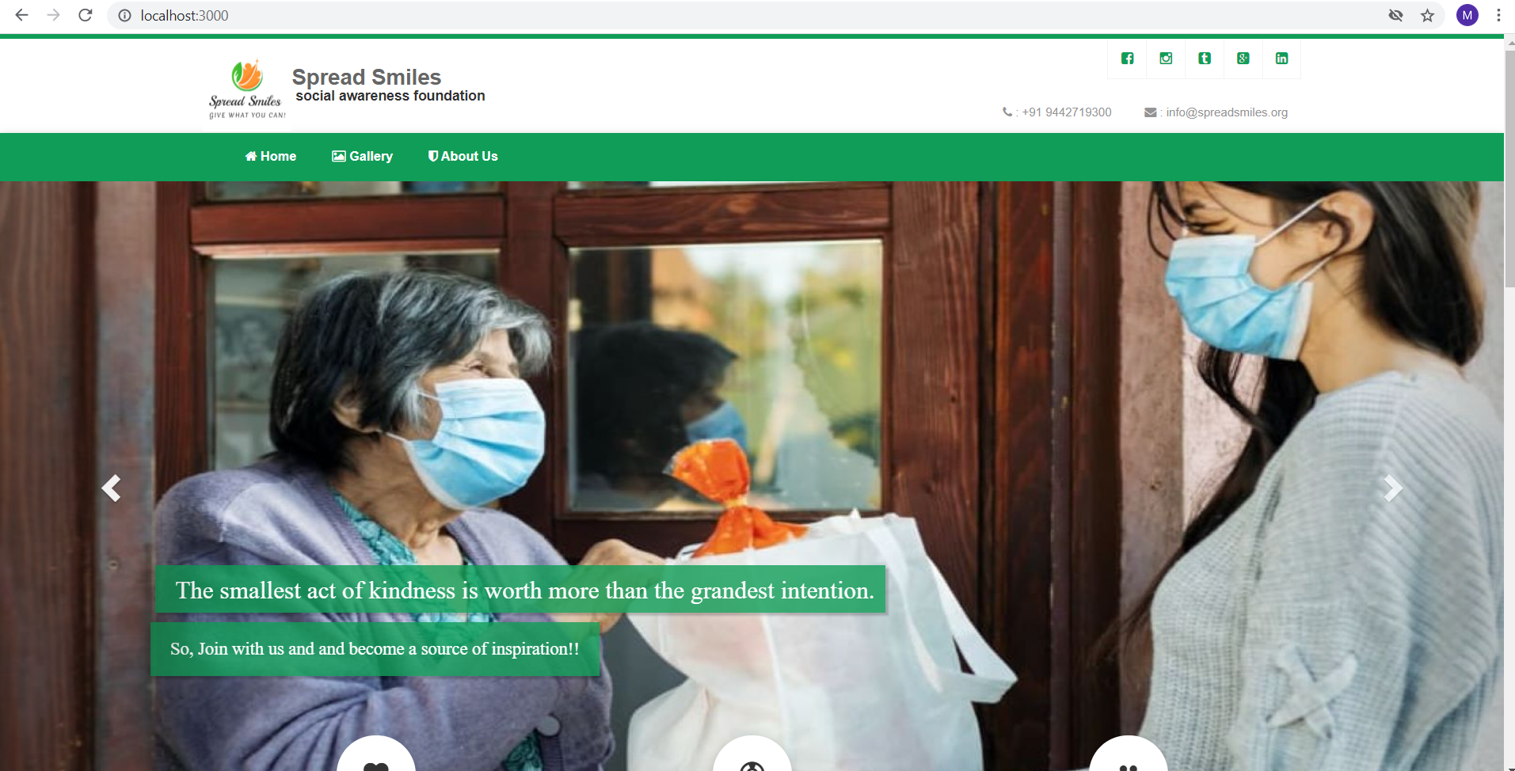

Slide 9
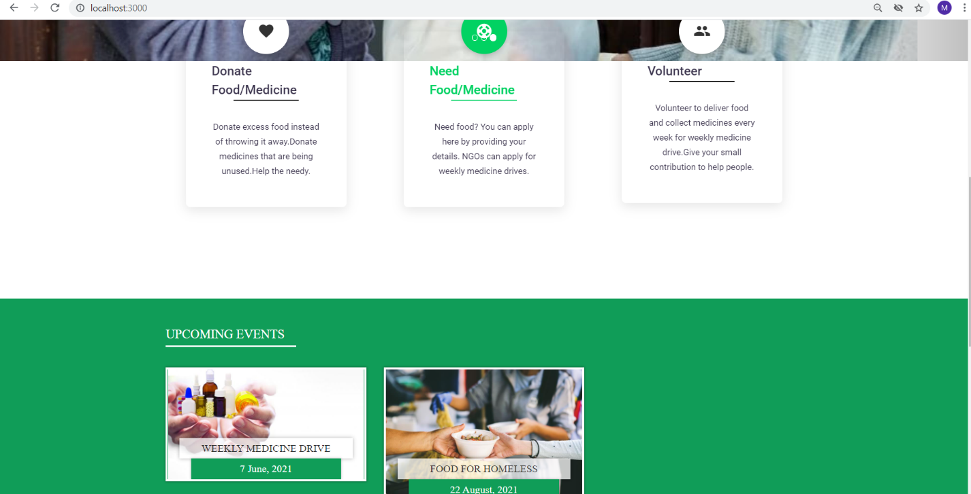

Slide 10
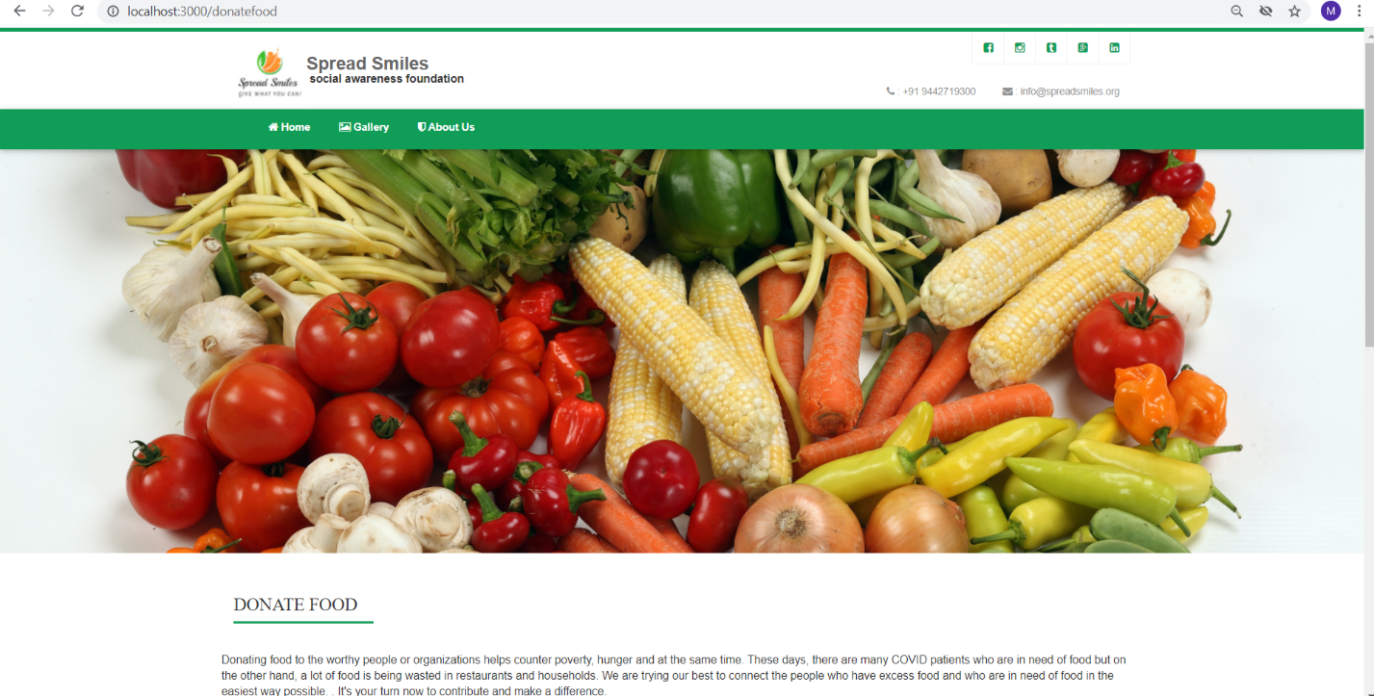

Slide 11
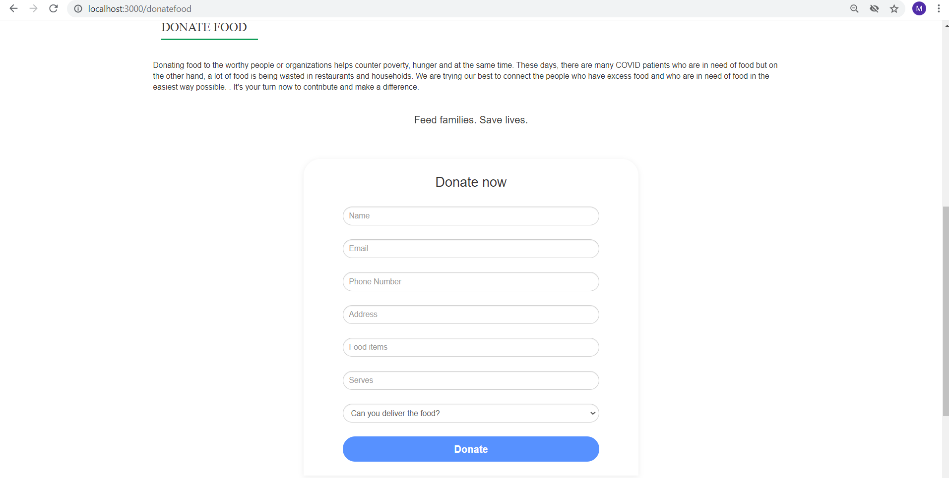

Slide 12
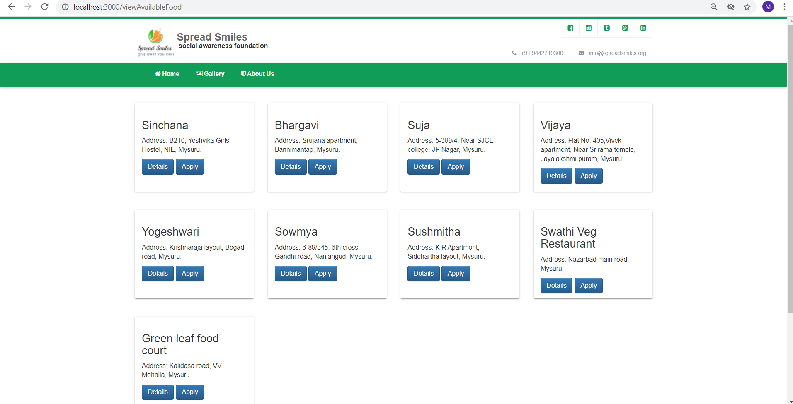

Slide 13
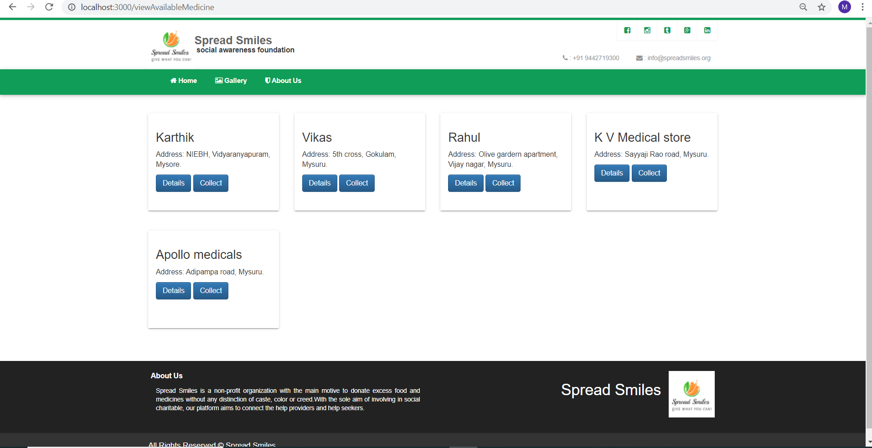

Slide 14
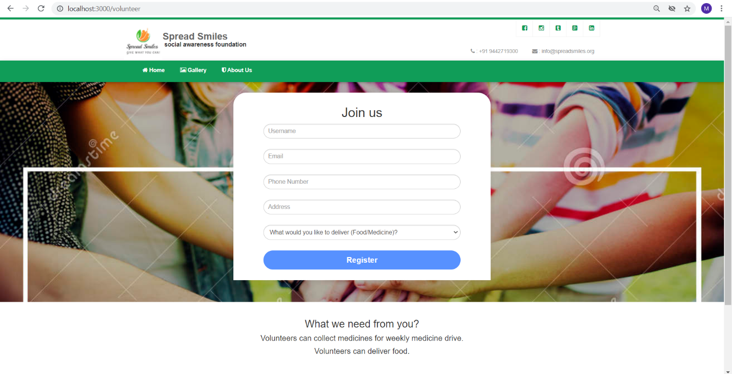

Slide 15
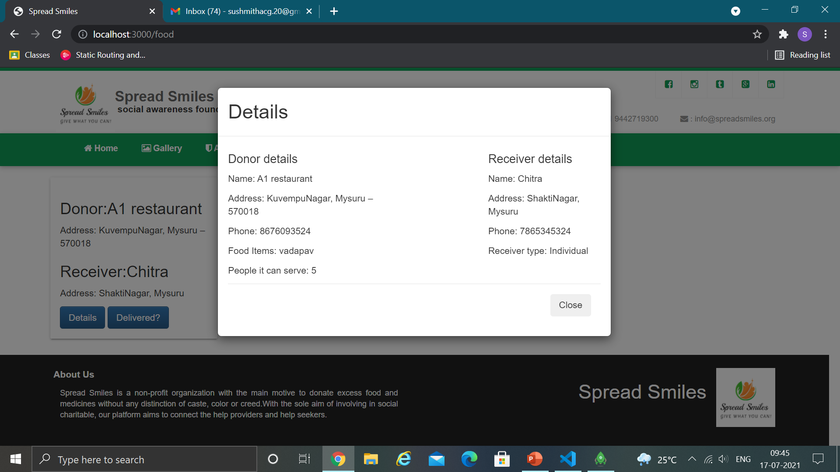

Slide 16
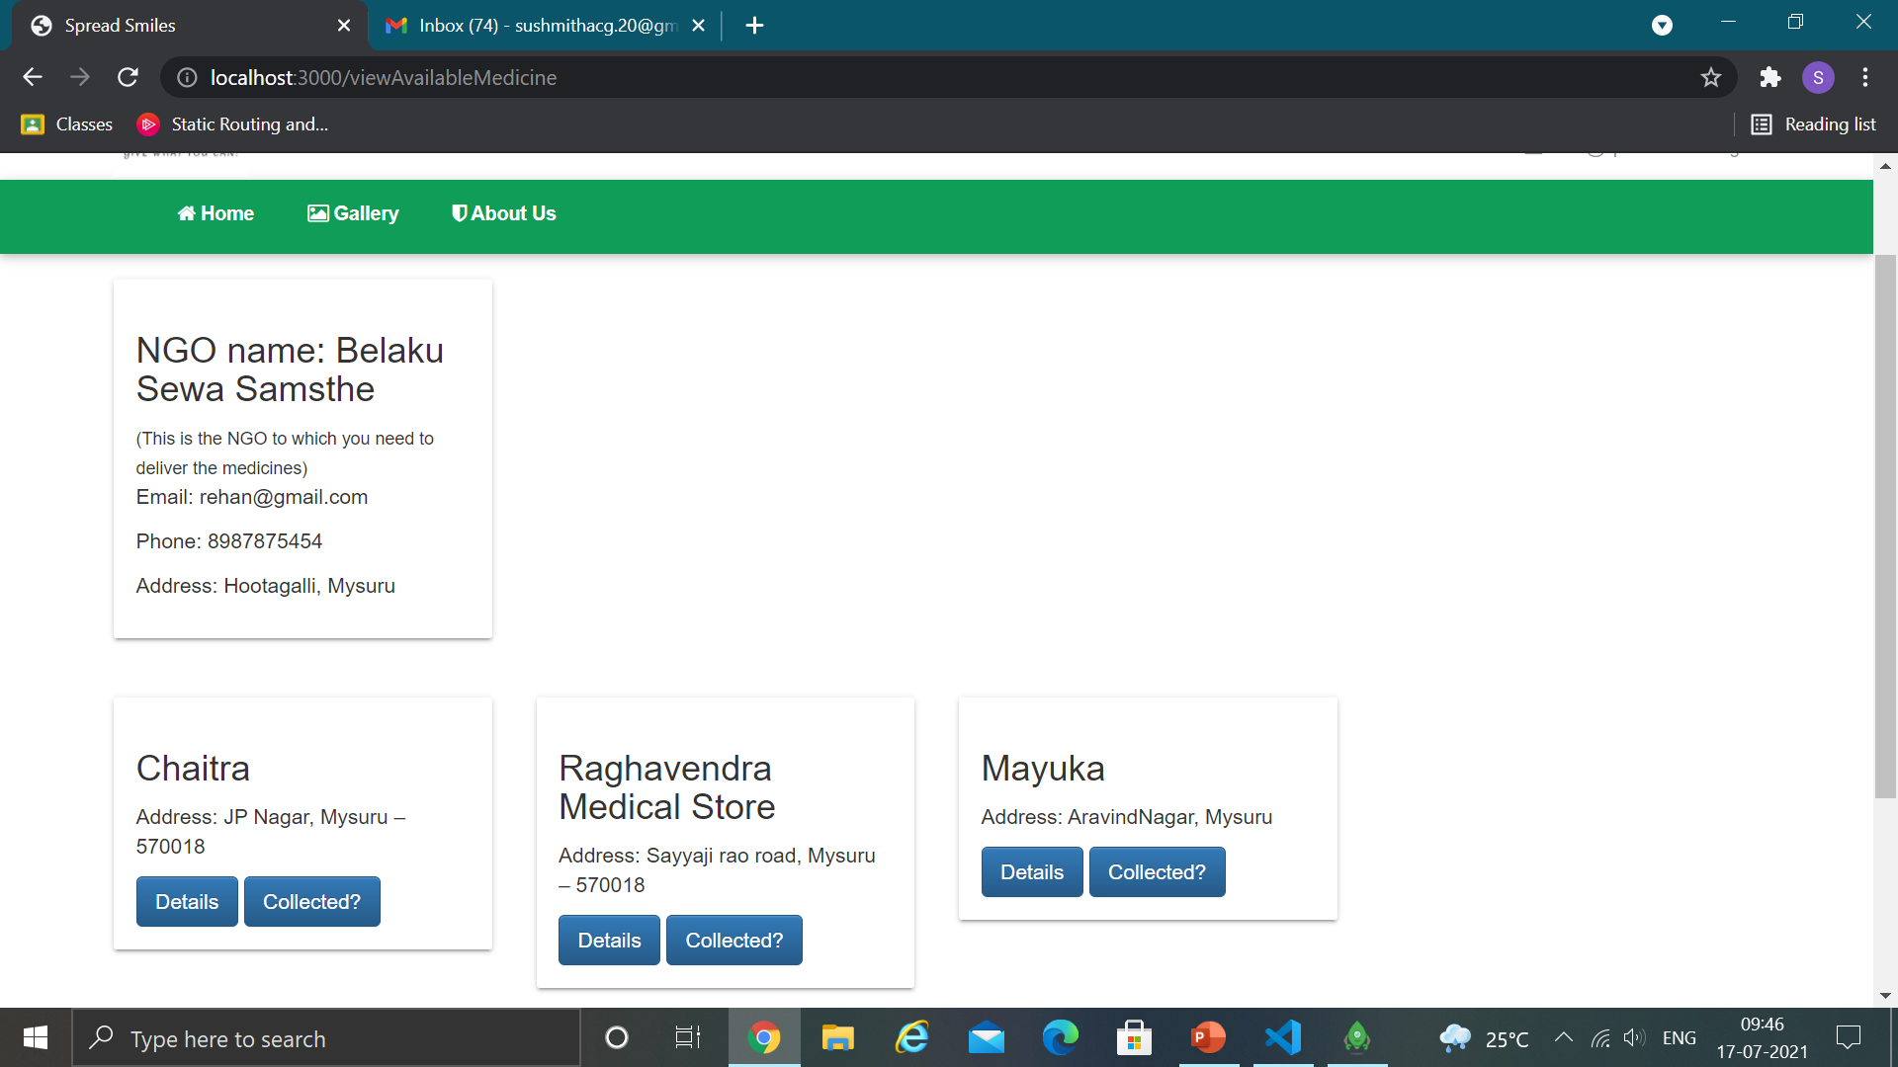

Slide 17
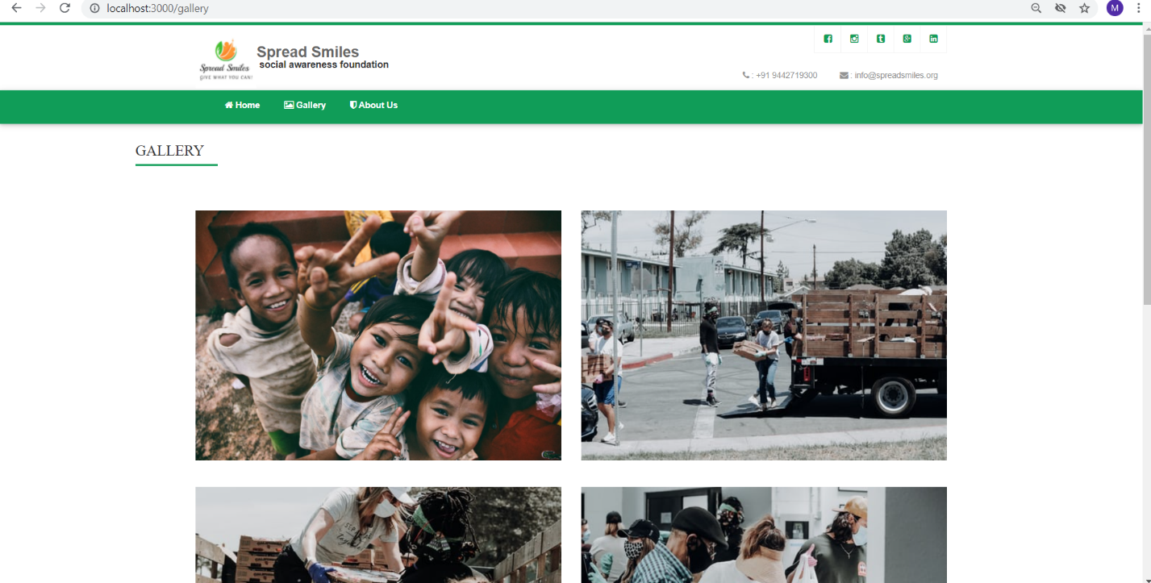

Slide 18
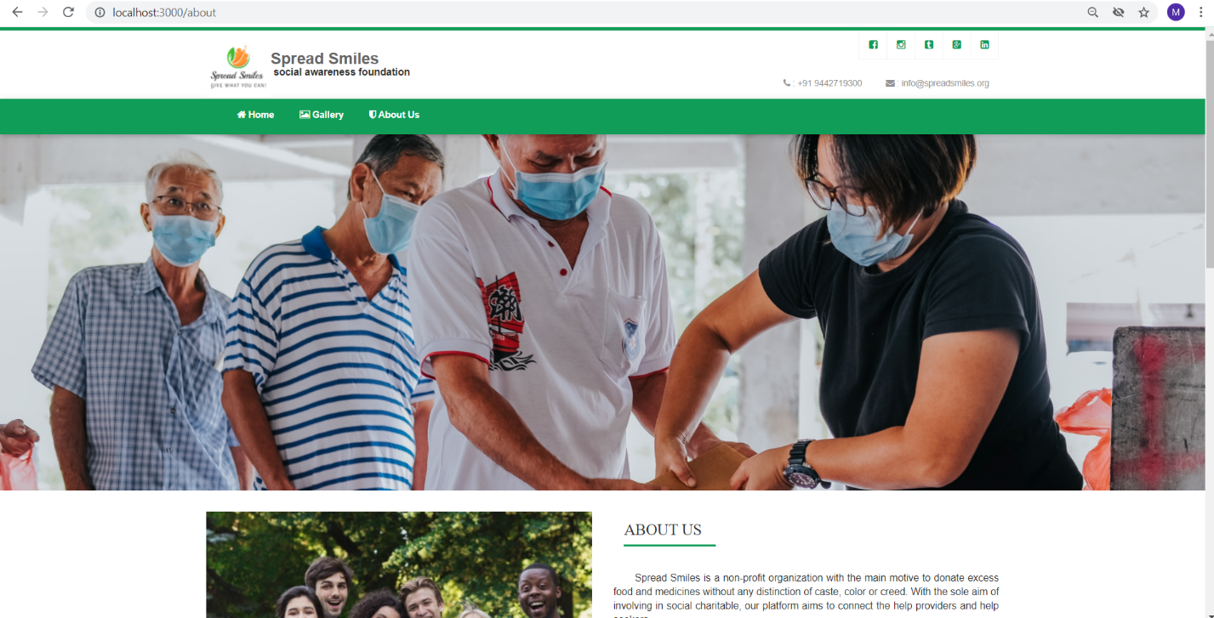

Slide 19
Conclusion
The COVID-19 pandemic is one of the worst health and economic crises in modern history. As we are all in these tough times together, this project is our idea to encourage small donations and help the needy.
In this collective fight against COVID-19, no amount is small to make a difference. Our website will be easily accessible by everyone and all the donations on this website will be genuine and transparent.
Provides a responsive interface with many features and data exchange between donors and help seekers becomes effortless.
This website makes helping each other easier, which is what exactly is needed in the current time.

